Slide 1
Matlab introduction

Slide 2
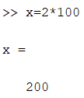
Basic operations
Use ctrl + r (in .m file) or ‘%’ to comment your code.
ctrl + t (in .m file) to uncomment.
Use semicolon ‘;’ at the end your command/line if you don’t want to show the result.

Slide 3
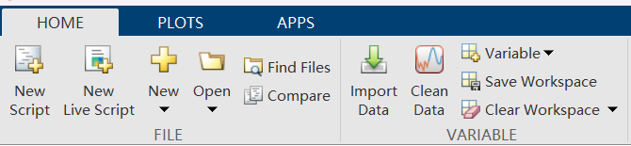
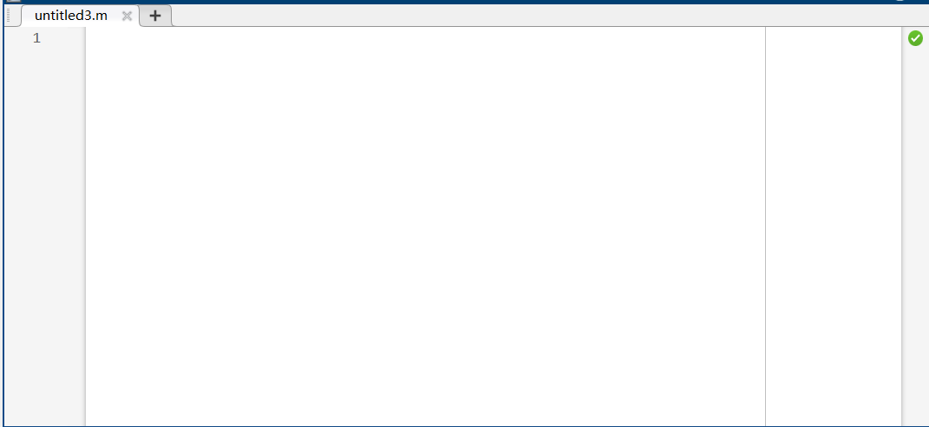
If you have a large amount of commands, you can put them in a .m file.

Slide 4
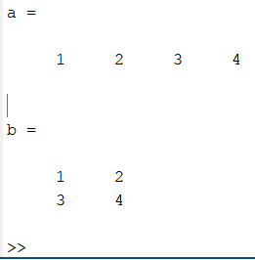
Matrix definition
a=[1 2 3 4] %1*4
b=[1 2;3 4] %2*2

Slide 5
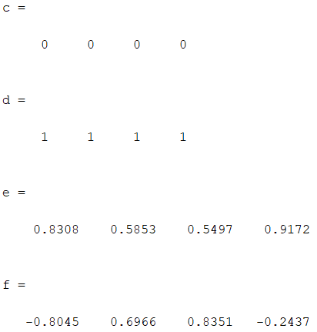
Some useful matrix
c=zeros(1,4)
d=ones(1,4)
e=rand(1,4)
f=randn(1,4)

Slide 6
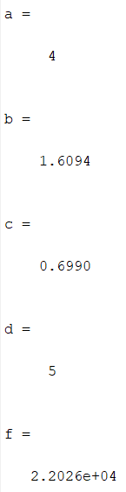
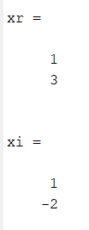
Some Mathematic functions
a=abs(-4)
b=log(5)
c=log10(5)
d=max([3 1 2 5])
f=exp(10)
xr=real([1+j;3-2j])
xi=imag([1+j;3-2j])

Slide 7
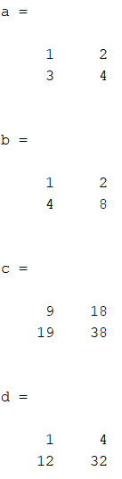
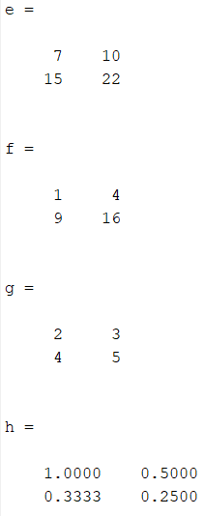
Mathematic operations
a=[1 2; 3 4]
b=[1 2; 4 8]
c=a*b
d=a.*b %point means elementwise operation
e=a^2
f=a.^2
g=a+1
h=1./a

Slide 8

Loops
x=0;
for i=1:10
x=x+i;
end
x

Slide 9

Conditional statement
x=-1;
if x<0
y=1;
elseif x==0
y=0;
else
y=-1;
end
y

Slide 10
Plot a function
We can only generate discrete-time signals.
To simulate continuous-time signal, we can make the sampling rate higher.

Slide 11
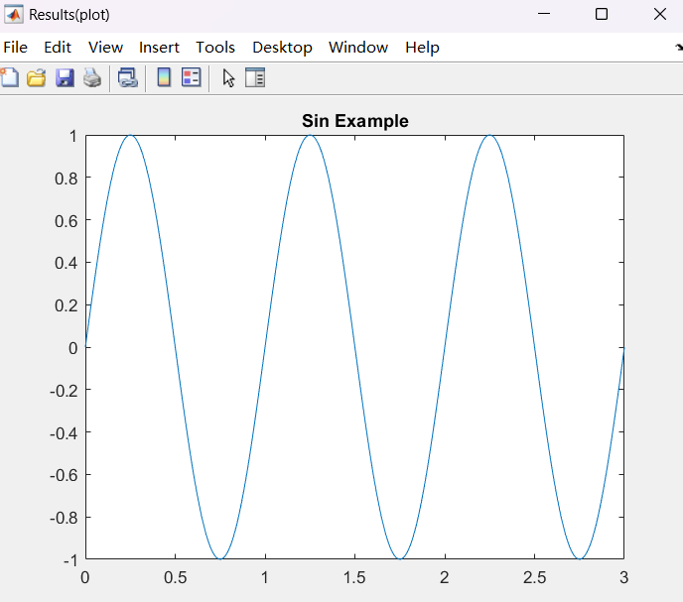
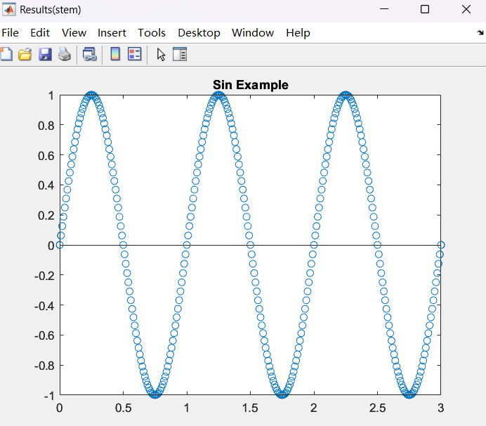
fs=100; % Sample frequency
f=1; % Frequency of sin
x=sin(2*pi*[0:1/fs:3]);
figure('Name','Results(plot)','NumberTitle','off');
plot([0:1/fs:3],x);
title('Sin Example');
figure('Name','Results(stem)','NumberTitle','off');
stem([0:1/fs:3],x,'LineStyle','none');
title('Sin Example');

Slide 12
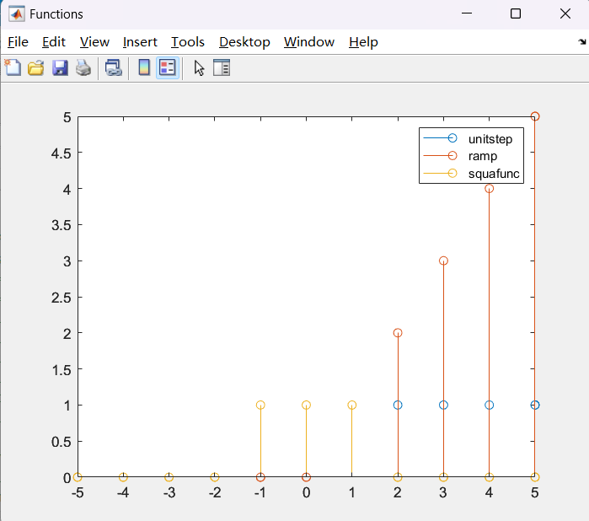
Convolution
t = -5:1:5;
% initialize
unitstep = zeros(size(t));
ramp = zeros(size(t));
squafunc = zeros(size(t));
unitstep(t>=0) = 1;
ramp = t.*unitstep;
squafunc(-1<=t &t <=1) = 1; %squarewave(-1<=t<=1)
figure('Name','Functions','NumberTitle','off');
stem(t,unitstep)
hold on
stem(t,ramp)
stem(t,squafunc)
hold off
legend('unitstep','ramp','squafunc');

Slide 13
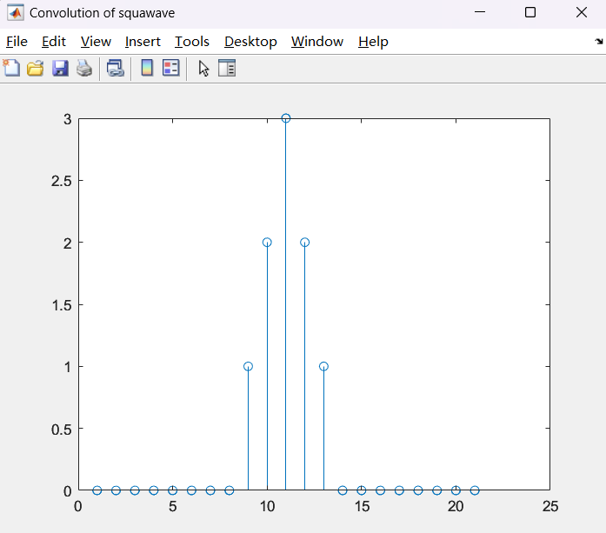
figure('Name','Convolution of squawave','NumberTitle','off');
a=squafunc;
b=squafunc;
c=conv(a,b);
stem(c);

